Slide 1
Fitness Activity Recognition
Fifth Week: 20 August to 26 August

Slide 2
Agenda
Final Algorithm (DTW)
Final Results (DTW):
Angle Visualizations in Videos
Results on different Exercises
Goals for next week
Q&A

Slide 3
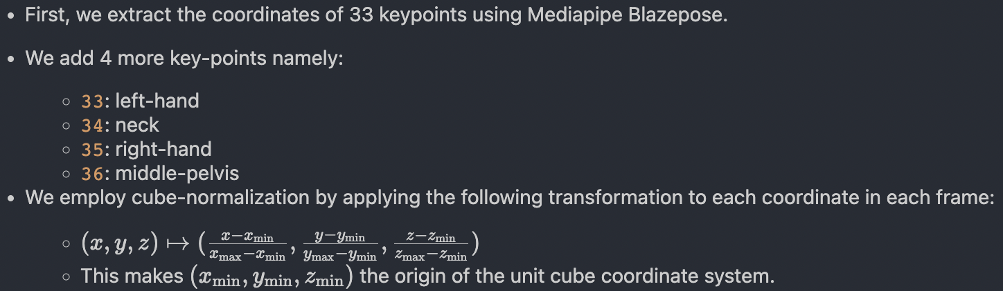
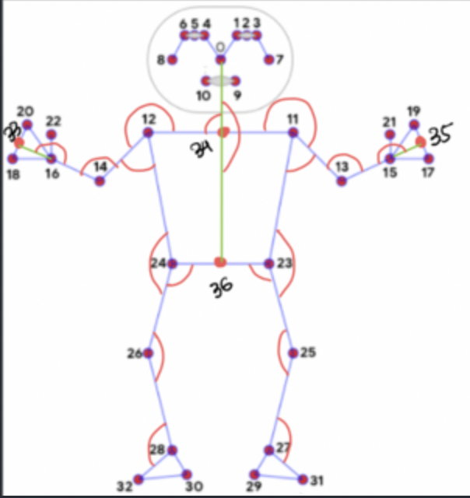
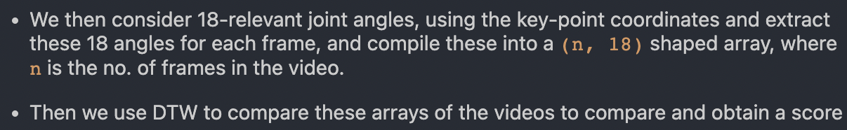
Final Algorithm (DTW)
Faster implementation of DTW using dtaidistance.dtw_ndim.distance_fast
Final Implementation at can be found here.

Slide 4
Final Results (DTW)

Slide 5

Angle Visualizations in Videos

Slide 7
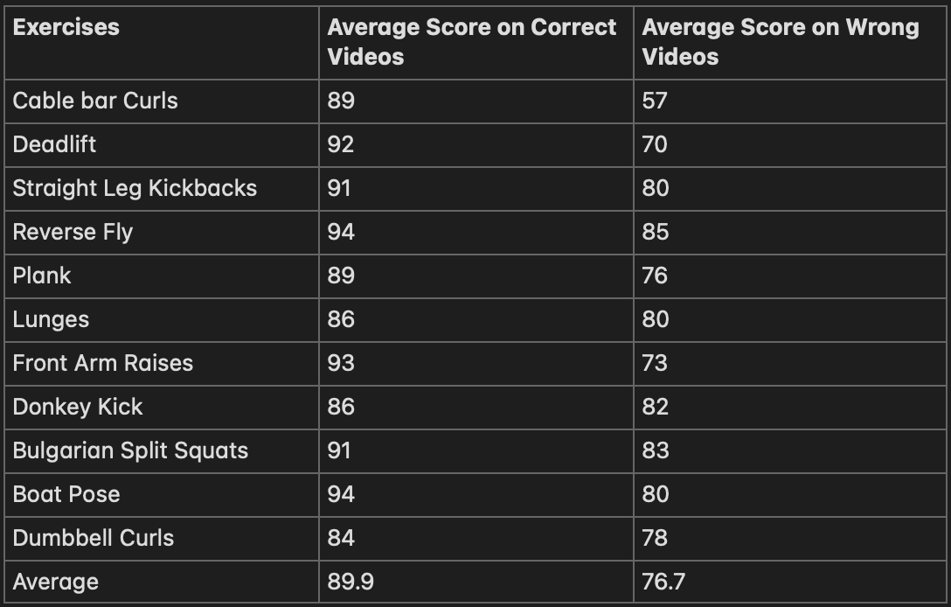
Results on different Exercises

Slide 8
Goals for next week
Wrapping up this approach
Continue research, read papers, Brainstorm!
Try discussing and reading autoencoder approach to encode videos and compare

Slide 9
Q & A

